Slide 1
Depression Detection on Multi-Modal Data
Under the supervision of Prof. Anupam Agrawal
Group No. - B8Gp1

Slide 2
Group Members
Khushi Gupta - IIT2019141
Hrithika Ratan - IIT2019147
Noonsavath Sravana Samyukta- IIT2019236

Slide 3
Agenda
Introduction
Literature survey
Problem statement and objectives
Methodology
Results
Dataset
Tools and Technology
Activity time schedule
References

Slide 4
Introduction
Globally, it is estimated that 5% of adults suffer from depression.
Approximately 280 million people in the world have depression.
There's no single cause of depression. It can occur for a variety of reasons and it has many different triggers.
For some people, an upsetting or stressful life event, such as divorce, illness, redundancy and job or money worries, can be the cause.

Slide 5
Motivation
The traditional approach to diagnosing depression relies on subjective self-reporting, which can be unreliable due to the stigma associated with mental health disorders, limited access to healthcare, and the reluctance of individuals to disclose their symptoms. Therefore, there is a need for a reliable and objective method of diagnosing depression.
Machine learning algorithms can effectively analyze multi-modal data and provide a more objective and accurate diagnosis of depression. These algorithms can learn patterns from large datasets and accurately classify individuals with depression from those without it.

Slide 6
Literature Survey

Slide 7
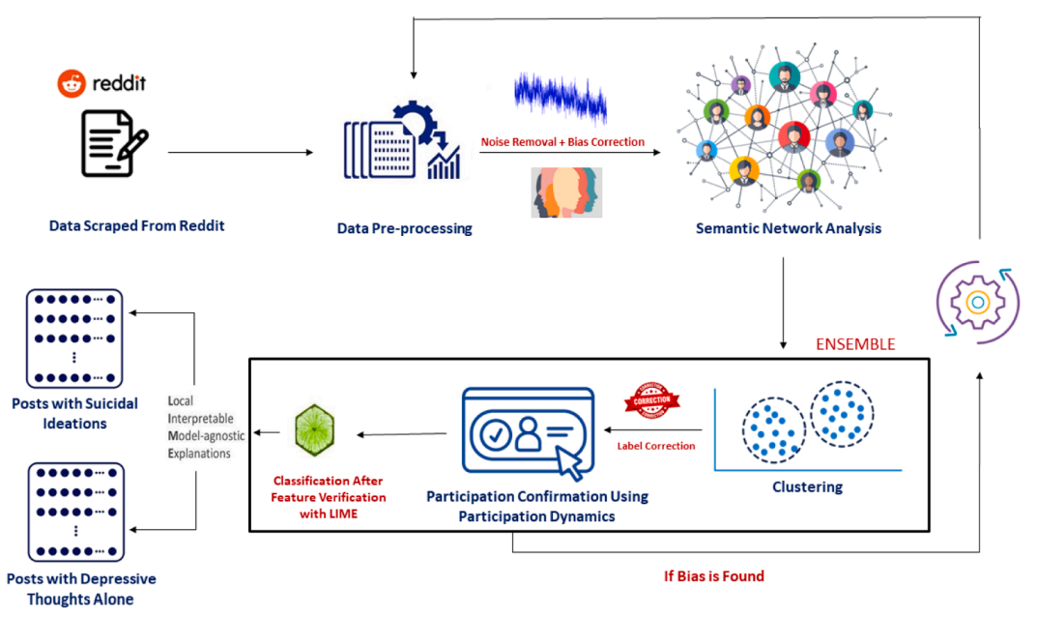
Fair and Explainable Depression Detection in Social Media [ 1 ]
Objective
"This paper aimed to identify and evaluate individuals at risk for developing a mental disorder and to look for early warning indicators of suicidal thoughts and behaviours."
Methodology
Natural Language Processing Tools are employed for Data Pre-Processing
Noise removal using Neural Machine Translator (NMT).
Bias normalisation using the one-shot decision approach.
Syntax Based Semantic Network Analysis is performed using the term frequency-inverse document frequency (TF-IDF).
Clustering
Participation Dynamics for Participation Confirmation
Classification
Explanation using LIME
Fig 1. Methodology chart [1]

Slide 8
Dataset
The data required for the study was obtained from Reddit, utilising the Reddit Application Programming Interface (API).
Result
This paper presents a reliable classifier that can compensate for any inherent bias that may have been introduced during the data gathering process to generate an objective model. Furthermore, the proposed ensemble model which includes clustering and classification presents a better result. A label correction with the NMT further tunes this method, and the bias variance is checked and fixed using the intrinsic explainability methods. Better classification accuracy is achieved.
Future scope
Plan to improve the way mental health themes are categorised by using multiclass classification.

Slide 9
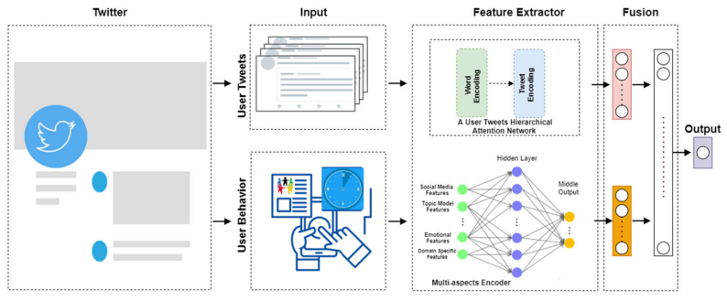
2. Explainable depression detection with multi-aspect features using a hybrid deep learning model on social media [2]
Objective
The aim is to propose a hybrid model based on Hierarchical Attention Networks (HAN) that combines with Multilayer Perceptron (MLP) to detect depression through social media
Methodology
For each user, the model takes two inputs for the two attributes. First, the four aspects feature input that represents the user behaviour vector runs into MLP (Multilayer Perceptron), capturing distinct and latent features and correlation across the features matrix. The second input represents each user input tweet that will be replaced with its embedding and fed to Hierarchical Attention Networks (HAN) to learn some representation features through a hierarchical word and tweet level encoding. The output in the middle of both attributes is concatenated to represent one single vector feature that fed into
Fig 2. Methodology chart [2]

Slide 10
Dataset
Depression data set: Each user is labelled as depressed, 2009-2016
Non-depression data set: Each user is labelled as non-depressed
Depression-candidate data set: The authors collected are labelled as depression candidate, where the tweet was collected if contained the word “depress”.
Result
The novel hybrid computational model for explainable Multi-Aspect Depression Detection with Hierarchical Attention Network (MDHAN) shows that training this hybrid network improves classification performance and identifies depressed users outperforming other strong methods and ensures adequate evidence to explain the prediction
Future scope
Will analyze users’ tweets by considering topics and sentiments simultaneously to provide supporting evidence for each Depression DSM-IV criteria. Will also go over social media content and use URLs, images, and a mix of short and long user-generated content with traditional web pages.

Slide 11
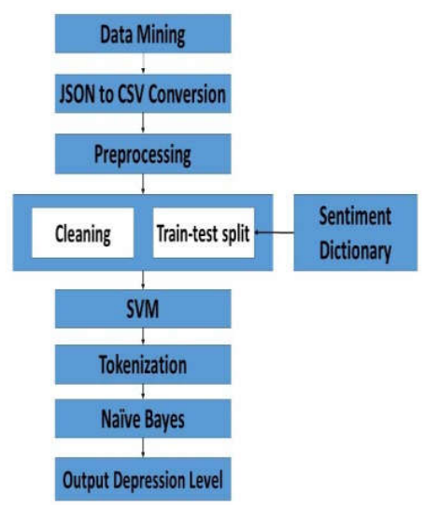
3. Depression Detection by Analyzing Social Media Posts of User [3]
Objective
In this research, depression level detection is done using machine learning approach by analyzing the social media posts of user.
Methodology
Fig 3. Methodology chart [3]

Slide 12
Dataset
Among SNS posts, tweets are collected using Beautiful Soup.
Result
This paper proposed a model that takes a username and analyzes the social media posts of the user to determine the levels of vulnerability to depression. The machine learning model is trained to classify the depression criteria in six ranges (Considered Normal, Mild, Moderate, Borderline, Severe, Extreme).
Future scope
The limitation of language in this model will be reduced and more than one language will be considered
as sample.

Slide 13
Challenges
Depression is a mental health condition that manifests differently in different people, and it can be difficult to identify objective measures that accurately reflect its presence or severity. Some symptoms of depression, such as sadness or fatigue, can also be experienced by individuals without depression, making it difficult to determine whether they are truly indicative of the condition.
Obtaining accurate and reliable labels for depression in multi-modal data can be difficult. Depression is a complex mental health condition that can manifest differently across individuals and may require clinical assessments or self-reporting. Ensuring consistent and reliable labeling across different modalities can be a challenge.

Slide 14
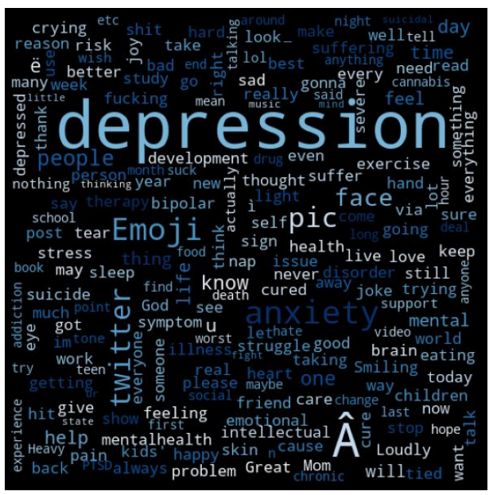
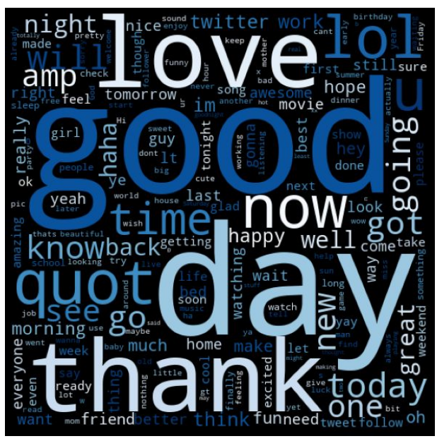
Fig 4. Depressive data word cloud [6]
Fig 5. Non-Depressive data word cloud [6]

Slide 15
Problem statement and objective
Our objective is to detect depression by modeling 3 different modalities sequences of an interaction between a human subject and a virtual agent.
The aim of this research is to explore innovative methodologies and techniques that leverage multi-modal data for accurate, reliable, and interpretable depression detection.

Slide 16
Proposed Approach
In order to detect whether individuals were depressed we conduct three sets of experiments using features extracted from the audio and text data to predict depression.
Experiment 1- A regularized logistic regression model without conditioning on the type of
questions asked.
Experiment 2 - A regularized logistic regression model with conditioning on the type of questions
asked.
Experiment 3 - An LSTM model using the sequences of responses, and without knowledge of the
type of questions that prompted the response.

Slide 17
Experiment 1: Context-free Modeling
Model
The predictive performance of several audio and text features is assessed when considered independently of the type of question asked, and time it was asked during the interview session. We provide audio and text features to a logistic regression model with L1 regularization.
Text features
Embeddings of individual responses to all queries were generated using Python Gensim library which were then trained with explored hyperparameters (minimum word counts, word context window, downsampling thresholds, hierarchical sampling, etc.). The hyperparameters that optimized the model’s performance on the training set was selected.
Audio features
- Initial set of frame level high-order statistic features of 79 COVAREP features provided with the DAIC Dataset were
extracted representing each subject response which composed of spectral, prosdic and voice quality.
- Segments with no audio information were set to 0 while Zero-mean and variance normalization was applied to the rest. - All features from the initial set without a significant univariate correlation with outcomes nor a significant L1
regularized logistic regression model coefficient were excluded , thus resulting in a subset of features and examples.
(responses).

Slide 18
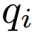
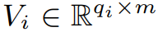
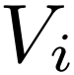
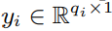
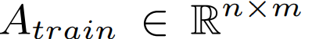
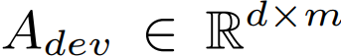
Experiment 2: Weighted Modeling
Model
- The predictive performance of several audio and text features is assessed when conditioning on the type of question asked, and independent of the time it was asked during the interview session.
- Audio and text features were provided to a logistic regression model with L1 regularization, and weighted the model probabilities based on the predictive power of the question found in the training set.
Assigning Question Value
- In our dataset, each subject i, was asked a subset of queries from a set of Q possible queries.
- Responses to the queries is represented as matrix where, m is the number of features.
- Each has a corresponding binary outcome vector indicating depression .
- Subject response matrices is horizontally concatenated into a training and development matrix,
and ; where n = no. of training examples
and d=no. of developmental examples

Slide 19
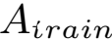
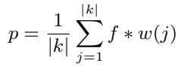
Experiment 2: Weighted Modeling (Contd.)
- Let c(j) represent performance of the trained model when evaluated using ‘s rows that
corresponded to a specific query, j {1 : Q}.
- Set of k informative queries are found with performance above a threshold θ: k = {j | c(j) >= θ}.
- For the subset of queries in k, we assigned query weights equal to the training set performance w(j) =c(j).
- These weights were used in conjunction with the logistic regression model f to provide a
question-weighted probability p of depression:

Slide 20
Experiment 3: Sequence Modeling
LSTM Model
For Audio + Text
We implemented a neural network model that takes two inputs: audio and text data, and outputs a binary classification prediction.
The audio input is of shape (batch_size, 250, 74) which means there are batch_size number of audio samples, each of length 250 time steps and with 74 audio features. The input is passed through three Highway layers and a Dense layer with 74 units before being merged with the text input.
The text input is of shape (batch_size, 250, 5100) which means there are batch_size number of text samples, each of length 250 time steps and with 5100 text features. The text input is passed through three Dense layers with 1000, 500, and 250 units respectively before being merged with the audio input.

Slide 21
Experiment 3: Sequence Modeling
LSTM Model
For Audio + Text
The merged inputs are concatenated along the time step axis, resulting in an input tensor of shape (batch_size, 500, 74). This merged input is then passed through an LSTM layer with 128 units and 20% dropout, before being passed through a Dense layer with a single output and sigmoid activation function for binary classification.
The model is compiled using the binary cross-entropy loss function and the Adam optimizer with a learning rate of 0.0001. The run_model function returns the compiled model.

Slide 22
Experiment 3: Sequence Modeling
LSTM Model
For Video + Text
We implemented a neural network model that takes two inputs:video and text data, and outputs a binary classification prediction.
It takes as input video data of shape (250, 388) and processes the video data and produces a feature vector of size 250.
The concatenate layer merges the feature vectors and the lstm layer processes the merged feature vectors and produces a fixed-size output vector.

Slide 23
Experiment 3: Sequence Modeling
LSTM Model
For Audio+Video + Text
The model consists of three input branches, one for each modality, which are then merged and processed through an LSTM layer and a final dense layer with sigmoid activation for binary classification.
The audio input has 250 timesteps and 74 features, the video input has 250 timesteps and 388 features, and the text input has 250 timesteps and 5100 features.
The highway networks and dense layers are used to reduce the dimensionality of each modality's input and extract relevant features. The LSTM layer is used to capture temporal dependencies across all modalities and make the final prediction.

Slide 24
Our Results
Sr. No | Features | Precision | Recall | F1 score | Accuracy
1 | Audio+Text | 0.93 | 0.93 | 0.93 | 93%
2 | Video+Text | 0.83 | 0.80 | 0.80 | 81%
3 | Audio+Video+Text | 0.96 | 0.95 | 0.96 | 96%

Slide 25
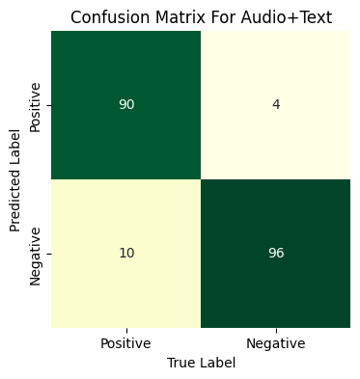
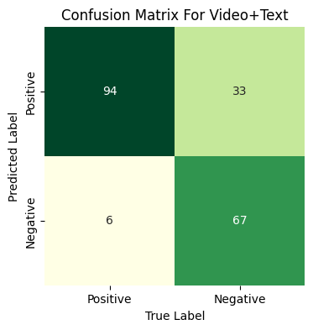
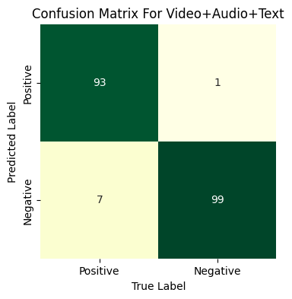
Confusion Matrix
Fig 6. Confusion matrix for Audio+Text
Fig 7. Confusion matrix for Video+Text
Fig8. Confusion matrix for Video+Audio+Text

Slide 26
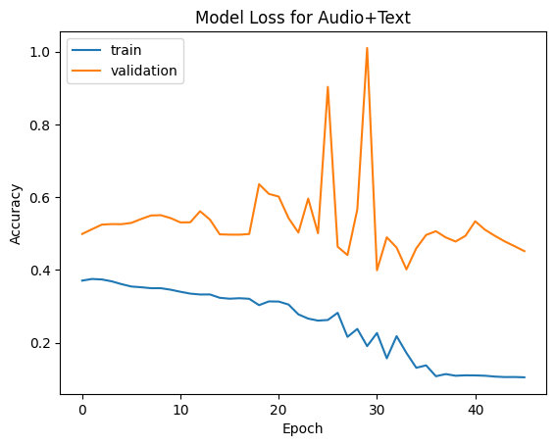
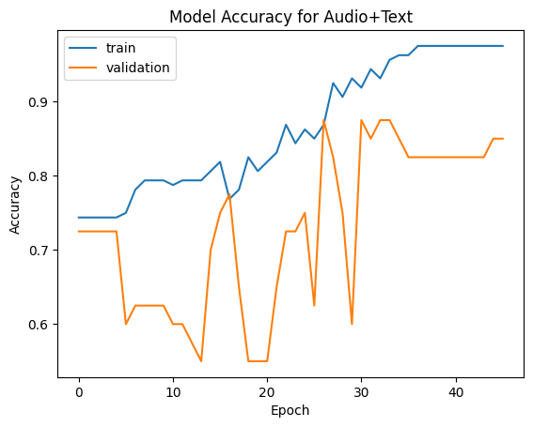
Audio + Text
Fig 9. Model loss graph for Audio+Text
Fig 10. Model accuracy graph for Audio+Text

Slide 27
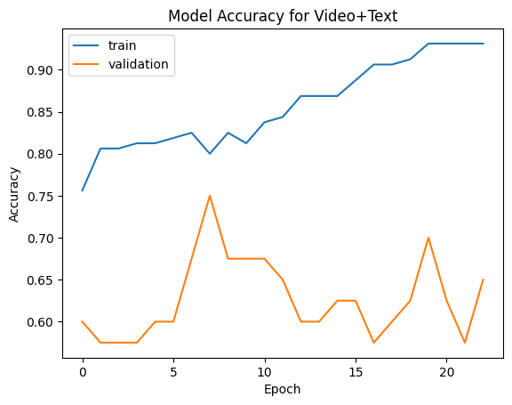
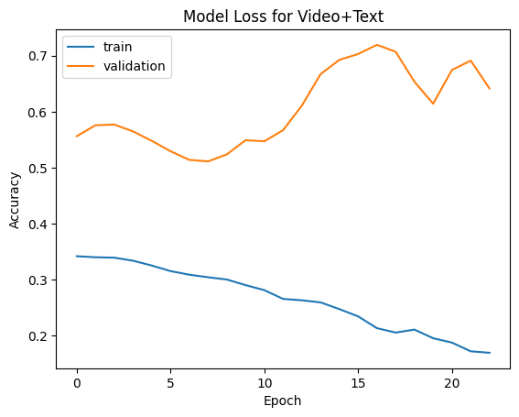
Video + Text
Fig 11. Model accuracy graph for Video+Text
Fig 12. Model loss graph for Video+Text

Slide 28
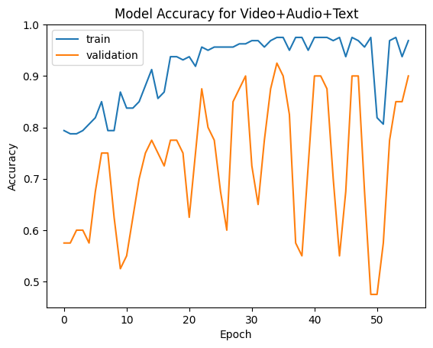
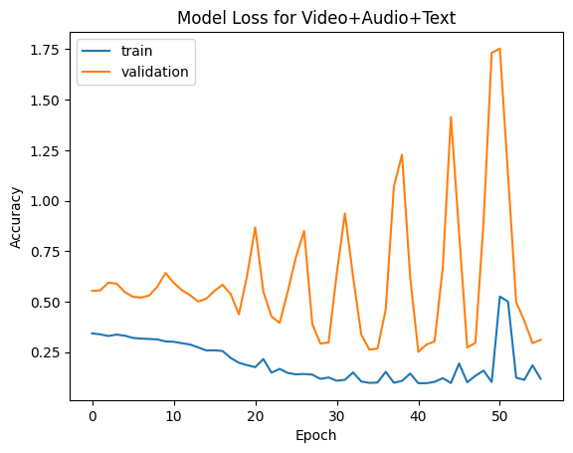
Audio + Video + Text
Fig 13. Model accuracy graph for Audio+Video+Text
Fig 14. Model loss graph for Audio+Video+Text

Slide 29
Dataset
We are using DAIC-WOZ dataset.
This Dataset contains audio, video and text transcriptions of individuals undergoing depression screening through a human-controlled virtual agent.
The dataset contains 189 sessions of interactions, ranging anywhere from 7 to 33 minutes. The dataset contains interviews with 59 depressed and 130 non-depressed subjects.

Slide 30
Dataset Modalities
1. Text Modality
Transcripts of the audio recordings, which were generated using automatic speech recognition (ASR) software. The transcripts include the text of the patient's speech, as well as any overlapping speech from the interviewer.

Slide 31
Dataset Modalities
2. Audio Modality
Recordings of patients speaking with a human interviewer in a clinical setting. The audio recordings were captured using a lapel microphone and include both the patient's speech and the interviewer's speech.

Slide 32
Dataset Modalities
3. Video Modality
This include facial landmarks, head pose, eye gaze, and facial action units.The facial landmarks are 68 points on the face that represent different regions of the face, such as the corners of the mouth, the tip of the nose, and the eyebrows. The head pose represents the orientation of the head in 3D space. The eye gaze indicates the direction of the subject's gaze, and the facial action units represent different facial expressions, such as smiles, frowns, and eyebrow raises.

Slide 33


Tools and Technology
We used python3 as a language for the code and NLTK for using packages and several libraries of python such as numpy, tensorflow, keras, pandas etc.
And we use google colab to run our code.

Slide 34
Activity Time Schedule
Importing
Dataset
Data Pre-processing
Classifier build
Depression
Detection
20 February
28 February
15 March
25 March
Final Testing
Improvement of the model
Training and Testing
10 May
5 May
26 April(Till C2)

Slide 35
References
[1] V Adarsh , P Arun Kumar , V Lavanya , G.R. Gangadharan, “Fair and Explainable Depression Detection in Social Media” 20 August 2022
[2] Hamad Zogan, Imran Razzak, Xianzhi Wang, Shoaib Jameel, Guandong Xu, “Explainable depression detection with multi-aspect features using a hybrid deep learning model on social media” 18 May 2021, World Wide Web (2022) 25:281–304
[3] Nafiz Al Asad, Md. Appel Mahmud Pranto, Sadia Afreen, Md. Maynul Islam, “Depression Detection by Analyzing Social Media Posts of User” , 2019 IEEE International Conference on Signal Processing, Information, Communication & Systems(SPICSCON) 30 November,2019, Dhaka, Bangladesh
[4] Babu, N. V., & Kanaga, E. G. M. (2022). Sentiment analysis in social media data for depression detection using artificial intelligence: A review. SN Computer Science, 3(1), 74. https://doi.org/10.1007/s42979-021-00958-1
[5] Alhanai, T., Ghassemi, M., & Glass, J. (2018). Detecting depression with audio/text sequence modeling of interviews. Proceedings of the Annual Conference of the International Speech Communication Association, INTERSPEECH, 2018-September, 1716-1720. https://doi.org/10.21437/Interspeech.2018-2522
[6] https://medium.com/analytics-vidhya/depression-detection-using-machine-learning-28bbe0571d22

Slide 36
THANK YOU!!

